Slide 1

OUR Moon and a Mollusk
Notes:
My presentation today is on our Moon, and a mollusk.

Slide 2
CONSILIENCE
con · SIL · ee · ence
Notes:
My word of the day is Consilience. I’ll explain that later.

Slide 3
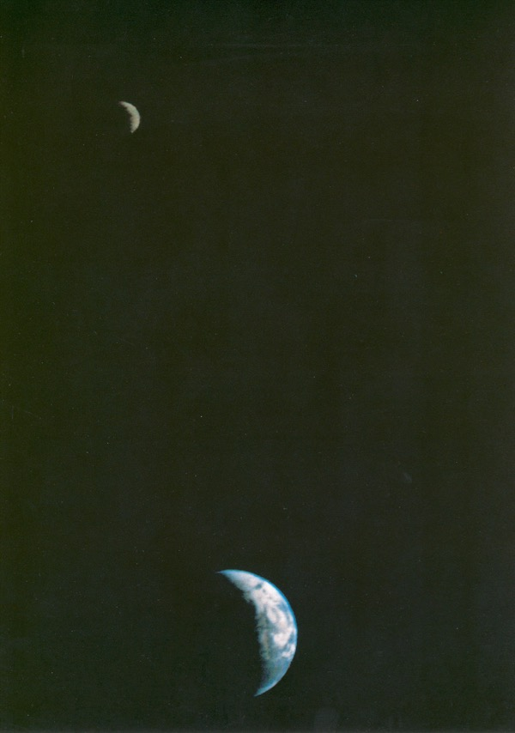
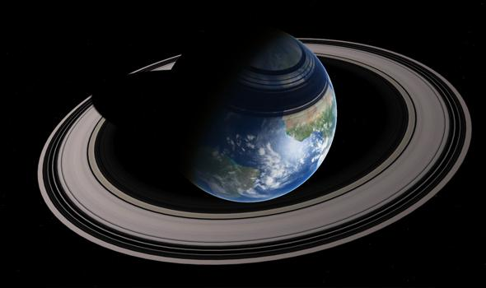
Now (238k miles)
Then (20k miles)
https://www.everythingselectric.com/moons-locked/
https://photojournal.jpl.nasa.gov/catalog/PIA00013
https://astronomy.com/magazine/ask-astro/2016/08/the-moons-rotation-rate
https://www.forbes.com/sites/quora/2018/07/11/what-did-the-moon-look-like-from-earth-4-billion-years-ago/#636c52611515
https://slate.com/technology/2014/05/close-encounter-what-if-the-moon-orbited-much-closer-to-earth.html
Notes:
Let’s start with the Moon.
The Moon is getting further away from the Earth, and it is slowing down.
When the Moon was created out of debris from a long ago impact about 4.5 billion years ago (more on that later) our Moon was much CLOSER to the Earth.
Scientists estimate it was orbiting about 15,000–20,000 miles away, as opposed to the current average distance of 238,000 miles. So early Moon appeared 15 times bigger on the horizon, and it would have glowed a dull red, because it was still molten! (Obviously this picture here is not to scale.)

Slide 4
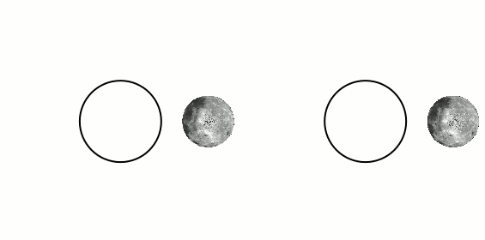
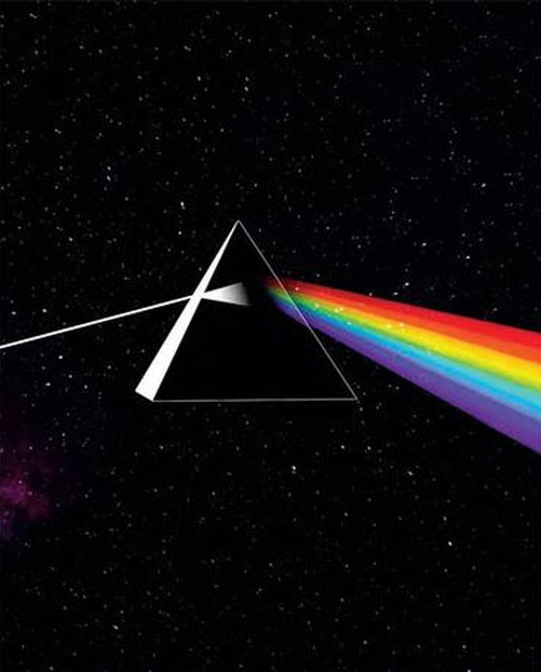
Tidally Locked Rotation
If the moon wasn’t rotating at all, we’d see all of it
https://en.wikipedia.org/wiki/Tidal_locking#/media/File:Tidal_locking_of_the_Moon_with_the_Earth.gif
Notes:
Because of tidal gravity action, the Moon’s rotation over billions of years slowed to only show us only one face, a concept called tidally locked.
<advance>
By the way there is no dark side of our Moon,
<advance>
there is only a side of the moon that Earth hasn’t seen in billions of years.

Slide 5
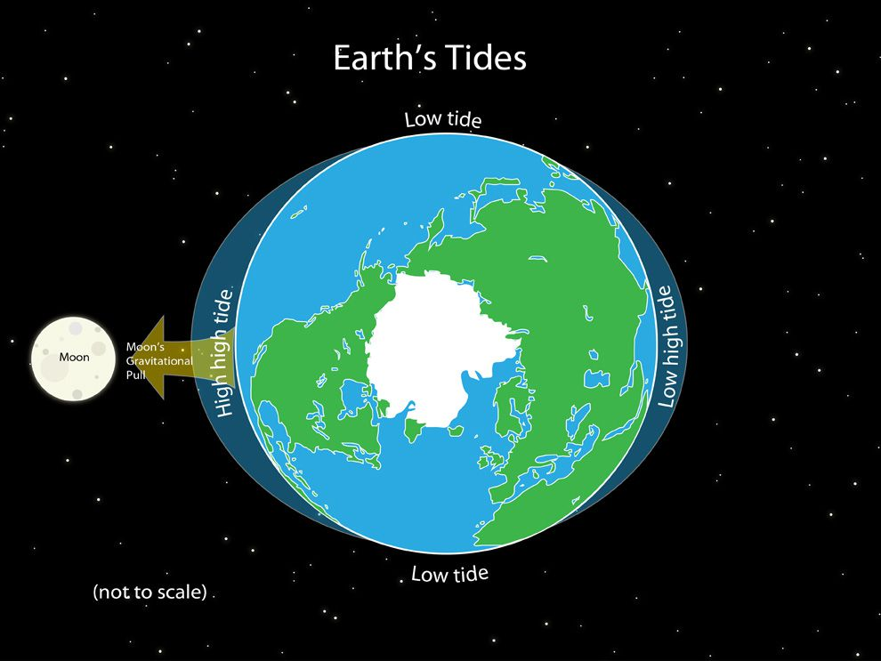
https://www.nationalgeographic.org/media/earths-tides/
https://futurism.com/a-rocky-relationship-is-the-moon-leaving-the-earth
Notes:
The Earth’s rotation is also slowing down.
Our Moon has a gravitation tug like friction, on the Earth. That’s why we have tides. The moon’s tidal gravity tug is slowly applying the brakes the Earth’s rotation. This saps energy from Earth’s rotation, which is why Earth’s days are getting longer — at about 2 milliseconds per century.
At this rate, in 50 billion years the Earth will be tidally locked and only show one face to the Moon, and our moon will settle into a nice stable orbit that will take about 47 days to go around the Earth. (Of course this will never actually happen because the Sun will explode before then, in about 5 billion years).

Slide 6
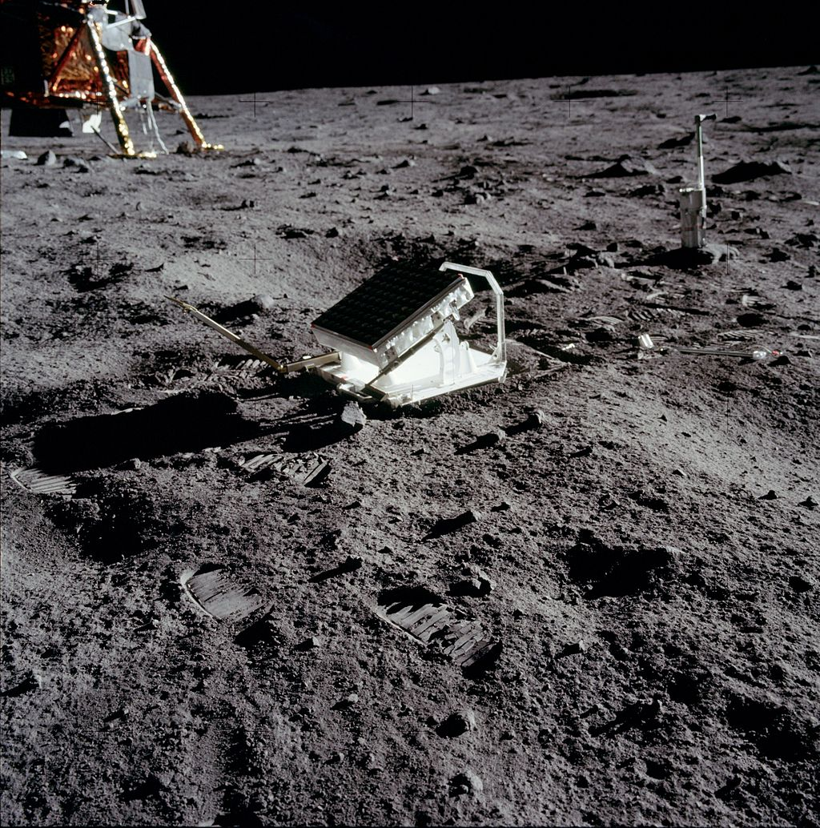
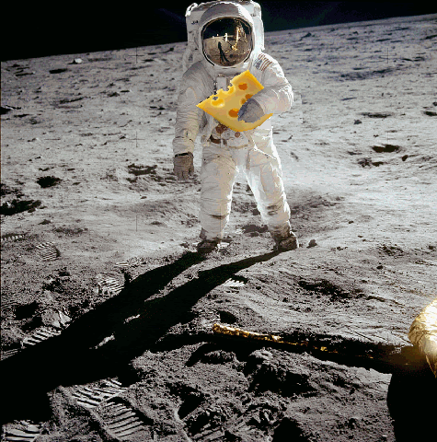
Our Moon is moving away from Earth 3.82cm per year… recently.
https://en.wikipedia.org/wiki/Lunar_Laser_Ranging_experiment#/media/File:Apollo_11_Lunar_Laser_Ranging_Experiment.jpg
Notes:
Our Moon is getting further away from the Earth by 3.82cm per year… recently.
We know this because the Apollo mission astronauts put reflectors on the moon, and we’ve been bouncing lasers off those reflectors for the past 50 years, so we have precise measurements of the Moon’s distance. But there’s two things we don’t really know.
The Moon’s retreat from the Earth hasn’t been a constant rate, so scientists have been trying to figure out how far away the moon was millions of years ago.
And we know that the length of the day of the Earth was SHORTER in the past. But how much shorter?
<advance>
And what the heck does this have to do with mollusks?

Slide 7
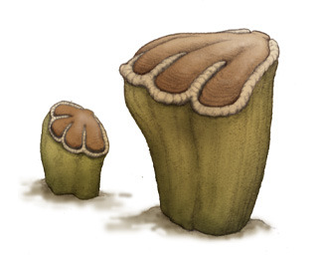
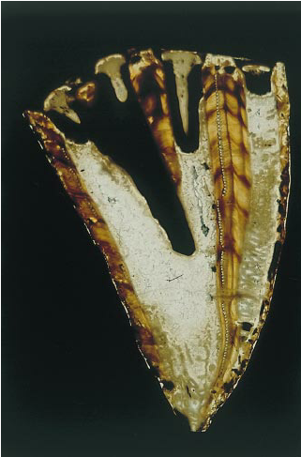
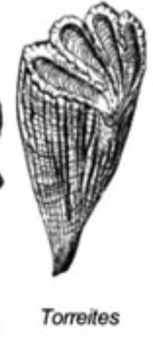

Torreites Sanchezi
https://palaeopedia.tumblr.com/post/55022020796/the-torreites-2002-phylum-mollusca-class
https://www.researchgate.net/figure/Longitudinal-thick-section-of-Torreites-sanchezi-milovanovici-H576-Chemical-and_fig1_201170170
https://www.universetoday.com/wp-content/uploads/2020/03/RudistTypes011511.jpg
https://www.mybluprint.com/recipe/bear-claws-recipe
http://www.sci-news.com/paleontology/cretaceous-earth-day-08211.html
Notes:
So, let me introduce the Torreites sanchezi mollusks. They looked like tall pint glasses, with lids shaped like bear claw pastries. They had two exquisite shells that met in a hinge, like asymmetric clams. They built huge dense reefs in warm oceans. They lived in the Late Cretaceous epoch and they were wiped out along with the dinosaurs (the non-avian dinosaurs anyway) more than 66 million years ago. (The avian dinosaurs obviously are the ancestors of what we see flying today.)
But we have nothing similar to these bivalves today, and scientists found these fossils in the arid mountains of Oman.

Slide 8
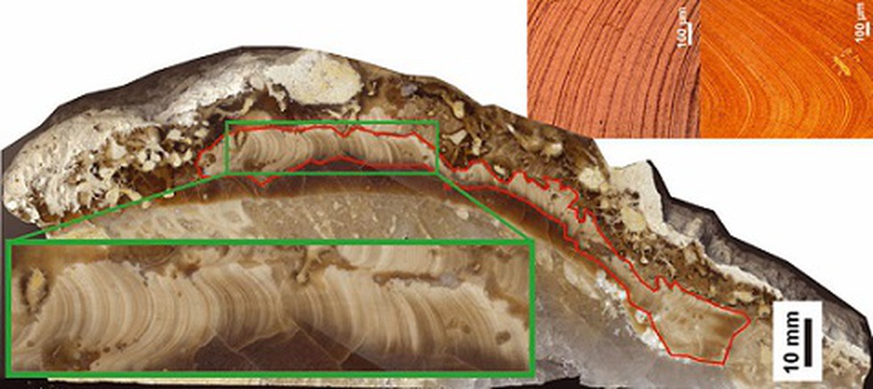

https://vajiramias.com/current-affairs/torreites-sanchezi/5e6efb251d5def7db691a894/
https://agupubs.onlinelibrary.wiley.com/doi/full/10.1029/2019PA003723
Notes:
These mollusks laid down a layer of calcium carbonate every day, and the thickness of the layer varied seasonally.
Researchers did a bunch of... well… research on these. Including with lasers! (And by the way that’s two different ways lasers have been used in this story!)

Slide 9
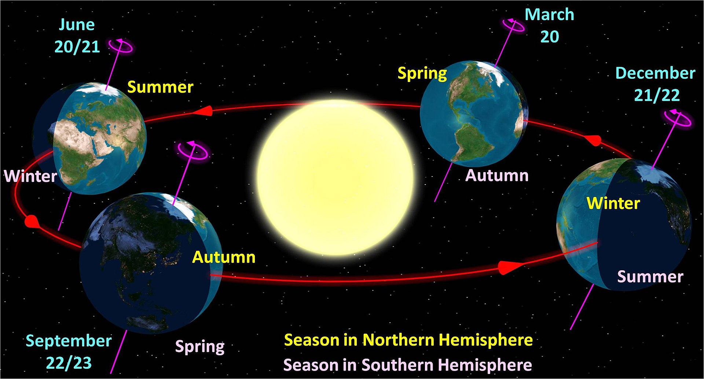
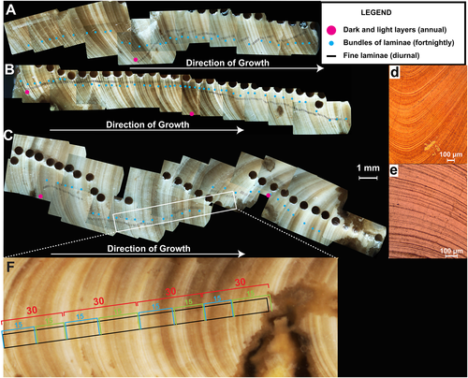
https://en.wikipedia.org/wiki/Earth%27s_orbit#/media/File:North_season.jpg
https://agupubs.onlinelibrary.wiley.com/doi/full/10.1029/2019PA003723
Notes:
Using this 66+ million year old natural biological clock, the researches were able to determine how many days a shell had collected, sure, but also the number of days in a season.
And so, they were able to determine that at that time, there were 372 days in a year, which is not a surprise, and so the days were shorter, 23.5 hours long. That’s easy math because we know the Earth’s orbit around the sun is the same, the length of a year is the same, and we understand how seasons work… so a year just had more days then.

Slide 10
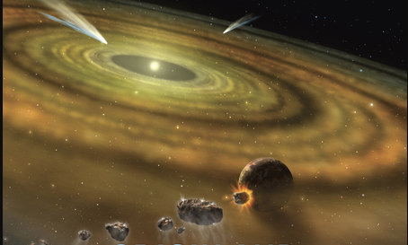
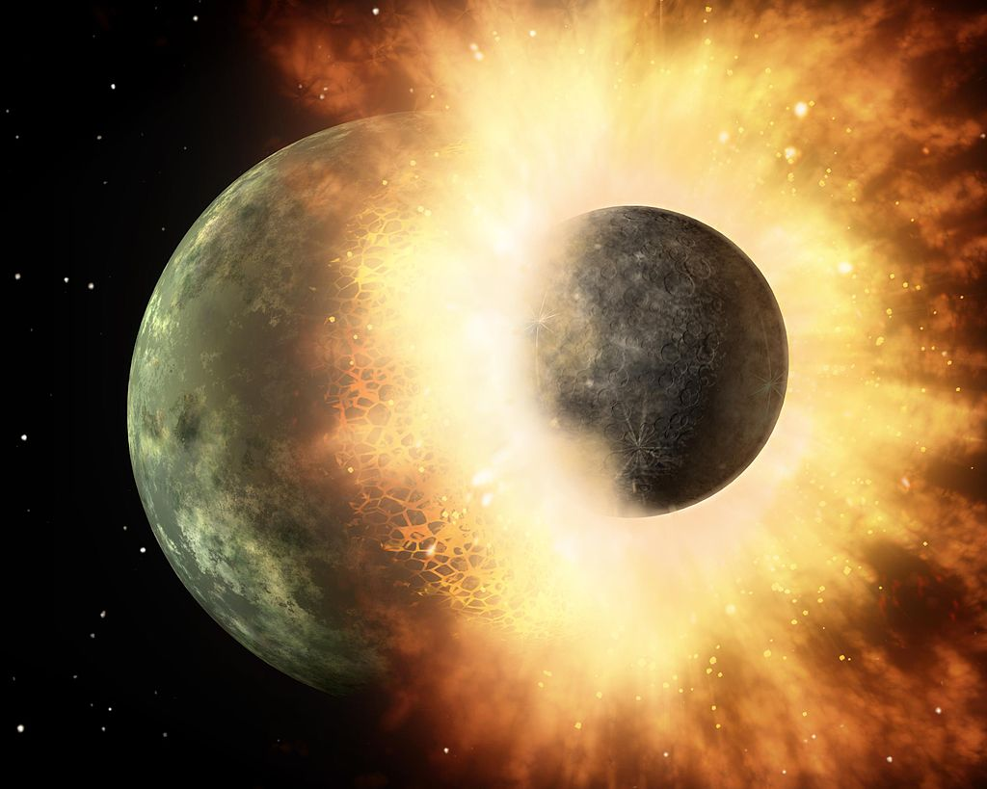
https://en.wikipedia.org/wiki/Giant-impact_hypothesis#/media/File:Artist's_concept_of_collision_at_HD_172555.jpg
https://www.mybluprint.com/recipe/bear-claws-recipe
https://www.nap.edu/cover/12161/450
https://agupubs.onlinelibrary.wiley.com/doi/full/10.1029/2019PA003723
Notes:
Scientists know that the moon probably coalesced around 4.5 billion years ago, after a massive collision between Earth and some other body formed the moon out of the debris.
Using this data from our extinct bearclaws, this is the first time we have evidence of specifically how fast the Moon has been moving away at a point further back in history.
So the Moon’s rate of retreat has changed over time, and a year in the life of an ancient pastry-topped mollusk, helps researchers reconstruct that history and model of the formation of the Moon.
By using this same technique on other shell-forming fossils, scientists are using Paleoceanography to lend a hand to Astrophysics, but with help from physicists, chemists, computer scientists, paleobiologists, paleoclimatologists, materials scientists, optical engineers, and the foundations created by many more scientific fields, not to mention the Apollo astronauts.

Slide 11
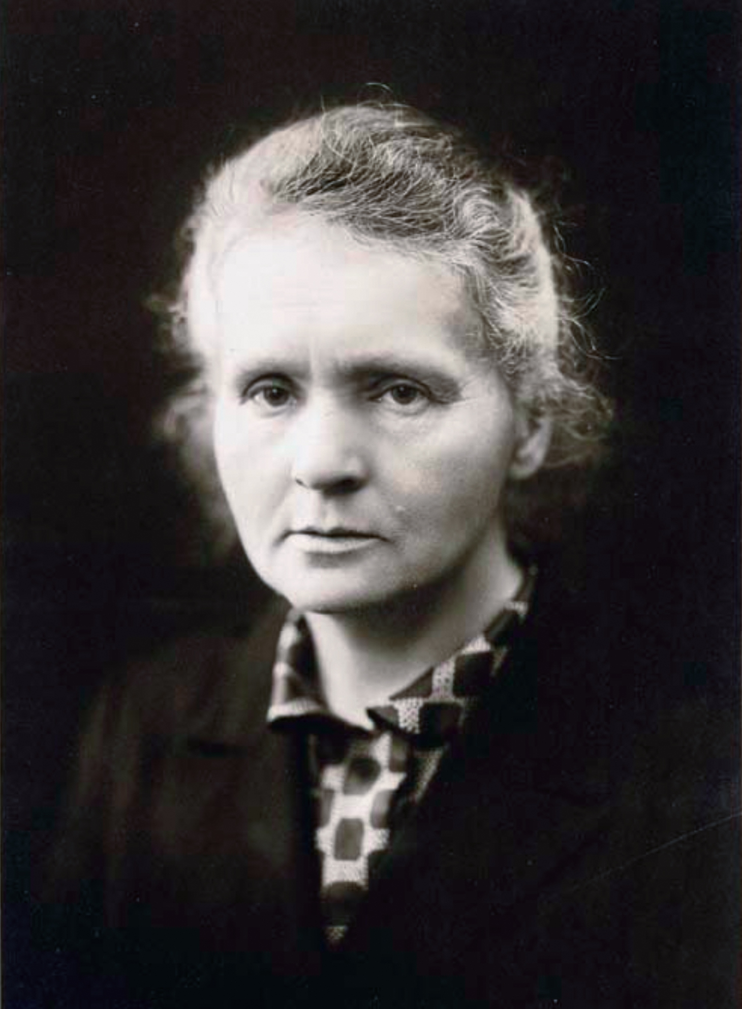
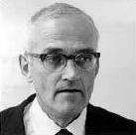
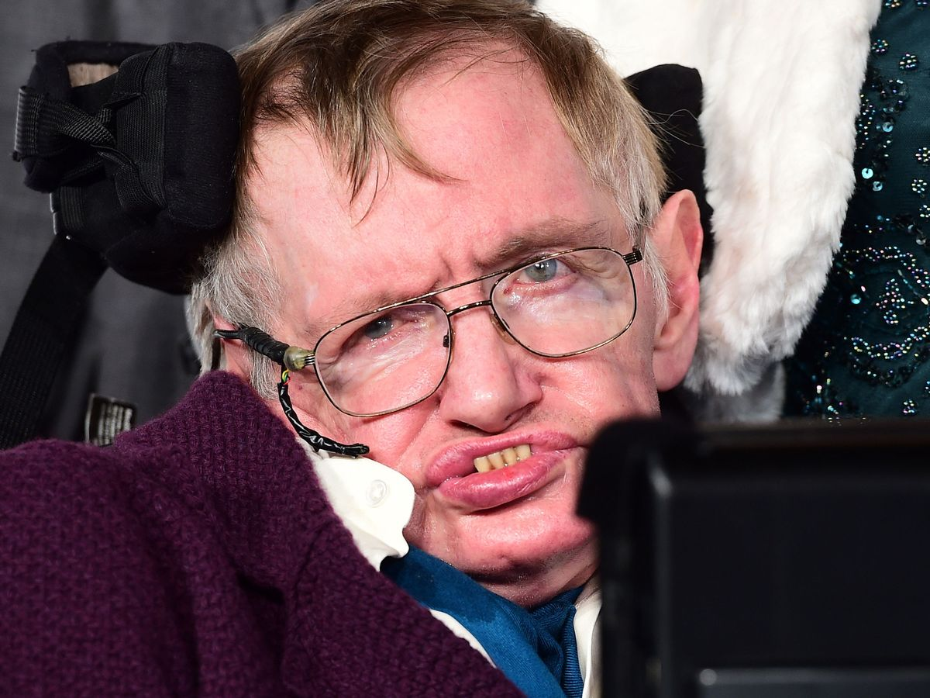
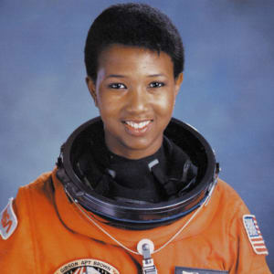
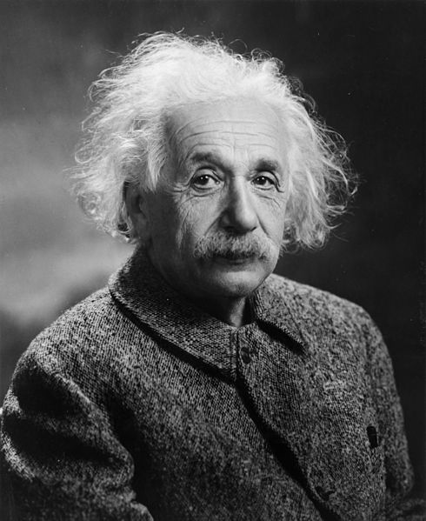
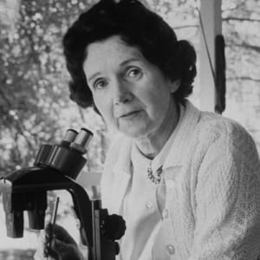

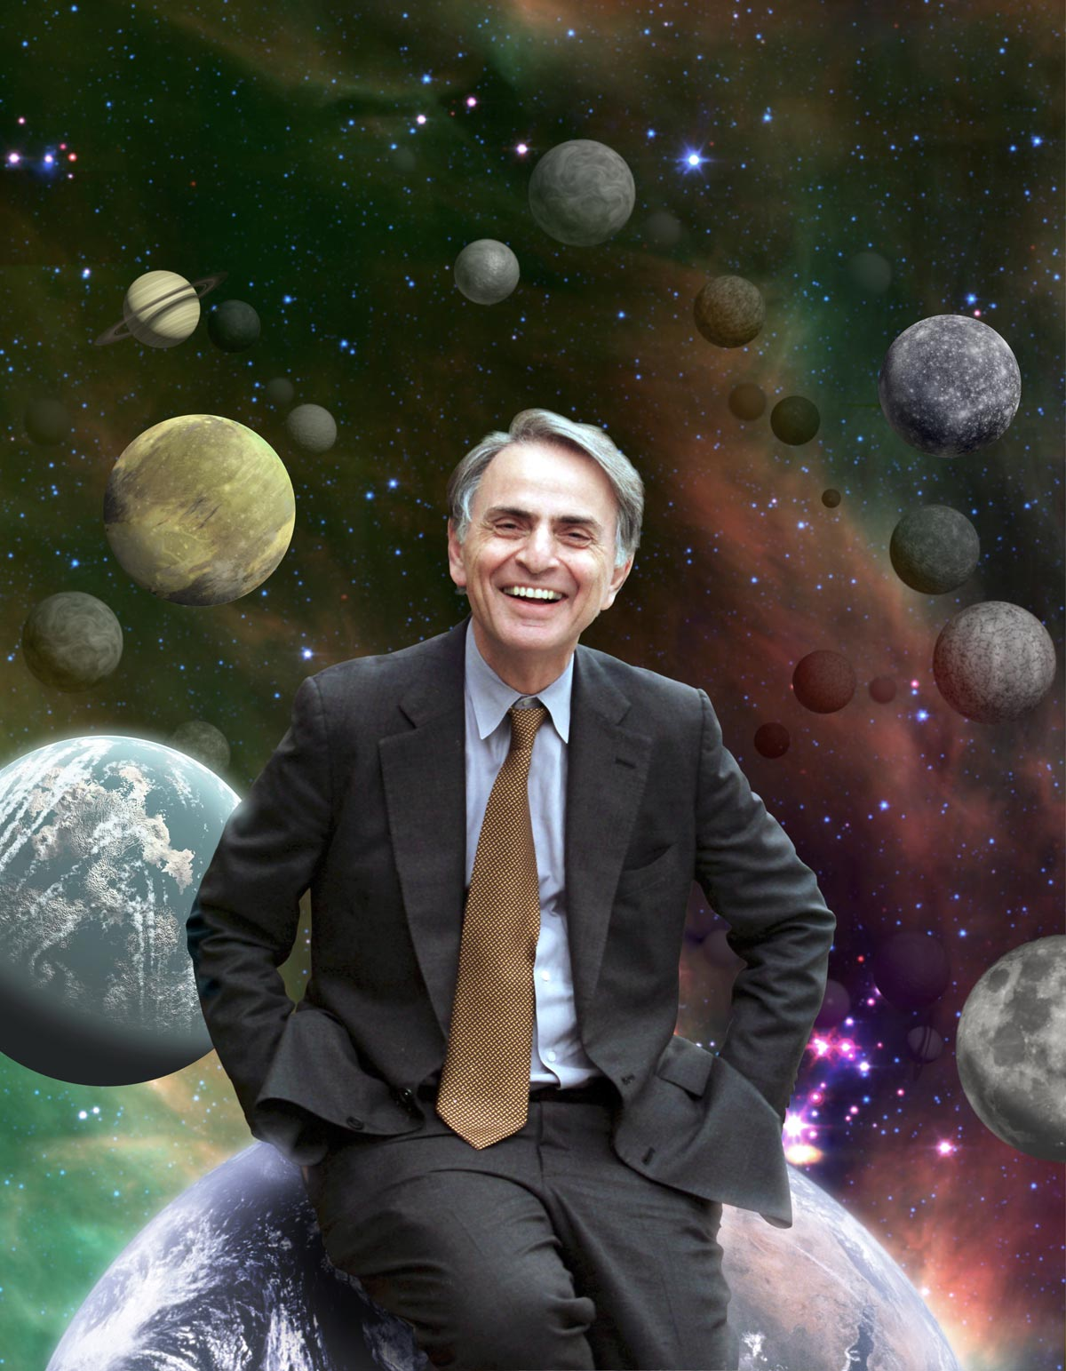
https://en.wikipedia.org/wiki/Clair_Cameron_Patterson
https://www.mirror.co.uk/science/professor-stephen-hawking-says-knows-12128613
https://en.wikipedia.org/wiki/Marie_Curie
https://www.biography.com/scientist/isaac-newton
https://commons.wikimedia.org/wiki/File:Albert_Einstein_1947.jpg
https://www.biography.com/scientist/rachel-carson
https://www.biography.com/scholar/ada-lovelace
https://solarsystem.nasa.gov/people/660/carl-sagan-1934-1996/
Notes:
So finally, that brings us to our word of the day.
Consilience is a word that describes when all the different branches and expertises of science, all those hypotheses and findings from all those different avenues of investigation, when they all agree on something, that’s really dramatically powerful, because they all describe one reality.
They may not all agree on every conclusion, and this understanding obviously changes over time, but science is a process that tries to discover facts. Consilience is when a jigsaw puzzle fits together.
And so the opposite of consilience is… really… bullshit.
Because bullshit, if you really try to stick with it, requires you to dismantle the knowledge of countless avenues of science, and countless scientists and millions of papers that are all describing reality.

Slide 12
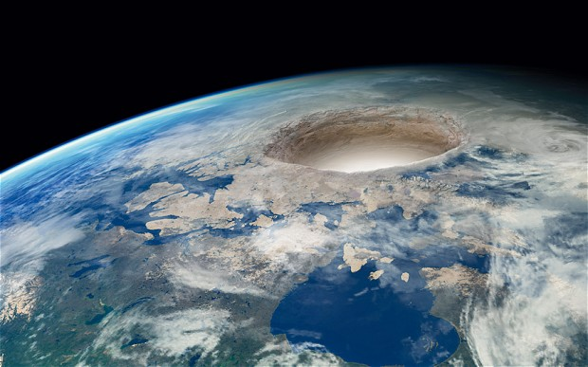
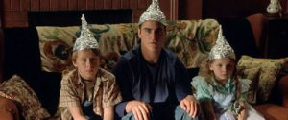



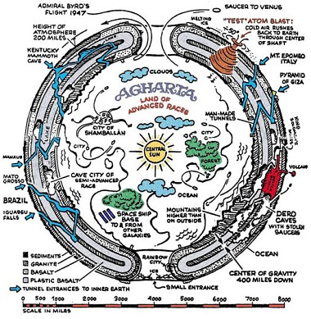




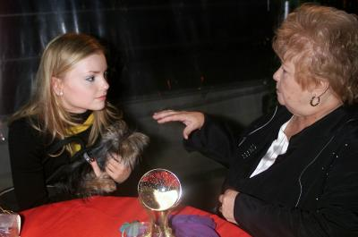

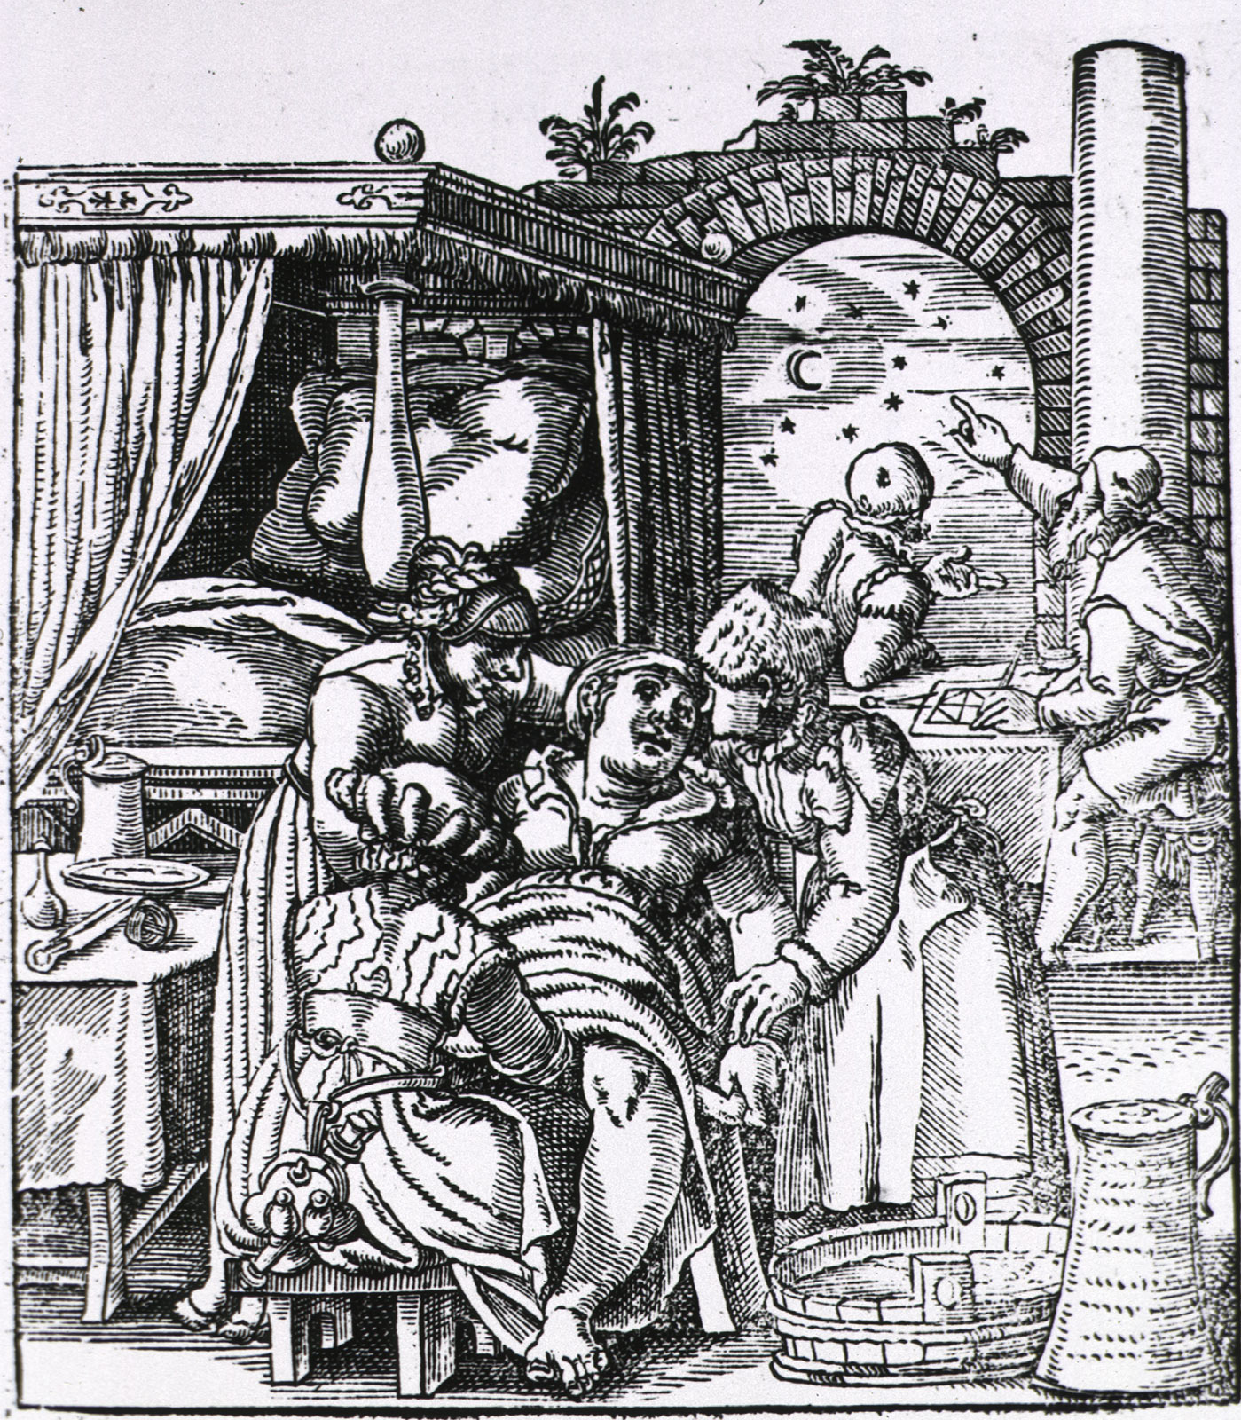
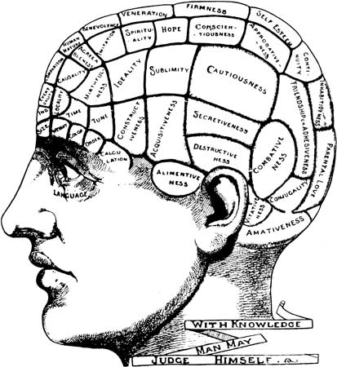
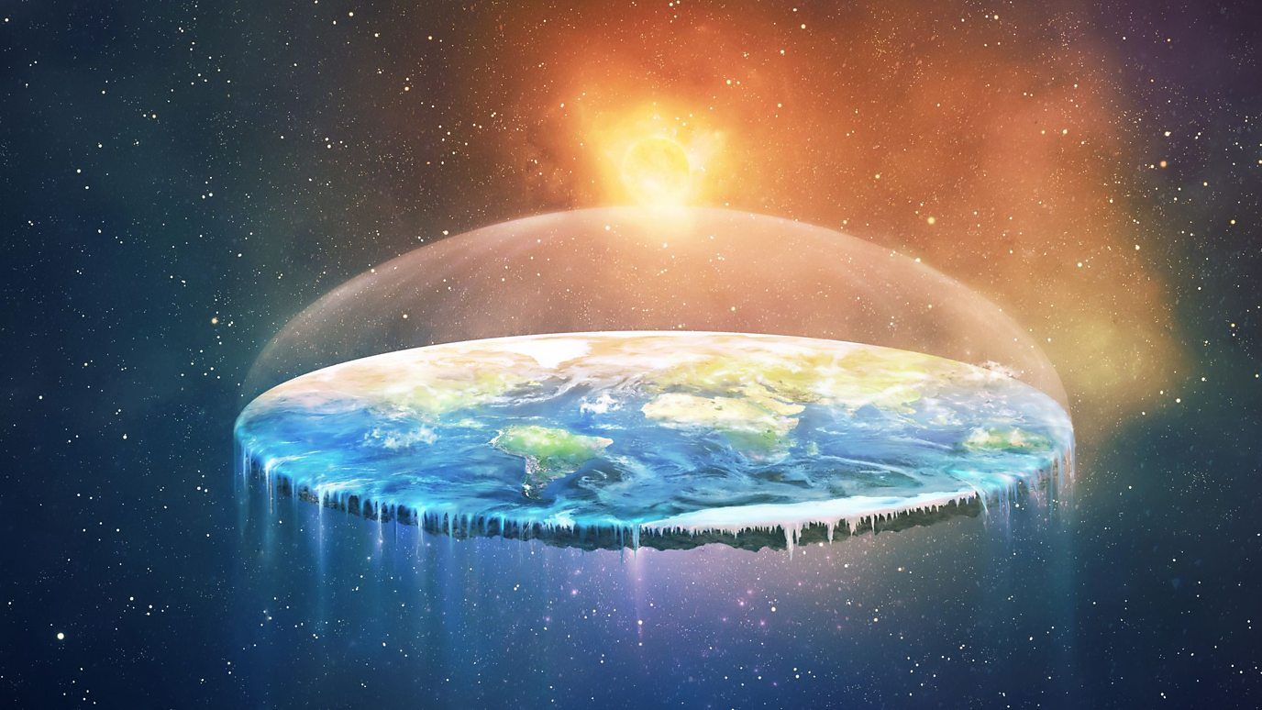
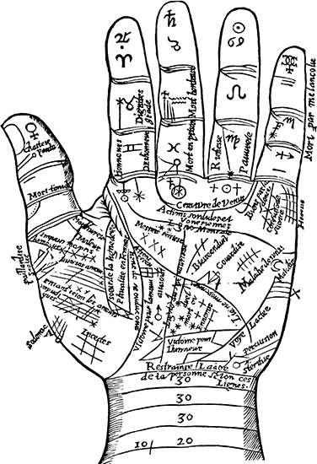

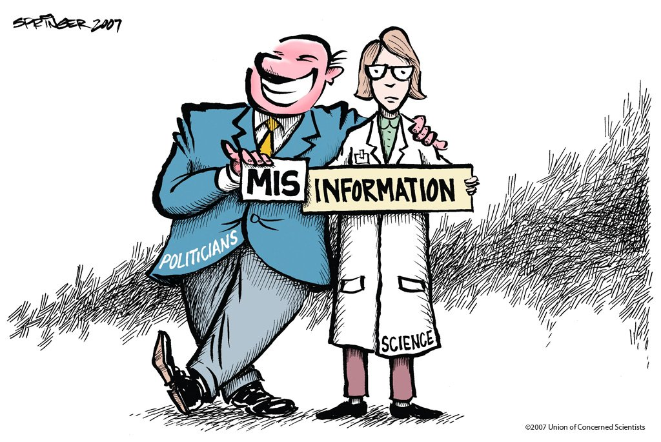


https://www.telegraph.co.uk/culture/books/10961412/Hollow-Earth-conspiracy-theories-the-hole-truth.html https://www.bbc.com/reel/video/p07h3yc0/flat-earth-how-did-youtube-help-spread-a-conspiracy-theory- https://sites.google.com/site/skepticalmedicine/pseudoscience https://kids.britannica.com/students/article/pseudoscience/276563#206937-toc
https://psychiclibrary.com/extrasensory-perception-esp/ https://www.patheos.com/blogs/abletochoose/2016/05/scientology-hubbard/
https://science.howstuffworks.com/science-vs-myth/extrasensory-perceptions/esp.htm https://skepticalinquirer.org/exclusive/neuro-pseudoscience/
https://www.dictionary.com/e/pop-culture/tinfoil-hat/
https://inthesetimes.com/article/21980/i-went-to-a-climate-change-denial-conference-heartland-institute-trump
https://blog.ucsusa.org/andrew-rosenberg/through-the-looking-glass-climate-change-denial-conflict-of-interest-and-connecting-science-to-policy-297
https://www.theverge.com/2020/3/13/21177998/new-york-attorney-general-alex-jones-infowars-coronavirus-cures-prevention http://www.stlamerican.com/your_health_matters/covid_19/missouri-sues-televangelist-for-selling-fake-coronavirus-cure/article_16559fe6-6954-11ea-900e-8fa886cdbccd.html
Notes:
So to insist that the earth is hollow, or the earth is flat, or that CO2 can’t cause climate change, or phrenology or astrology or whatever came before germ theory or telepathy or telekinesis, or that colloidal silver cures all ills including covid-19… whatever, but when trying to rationalize this belief outside of that tiny bubble, reality stands firmly in the way. Science is a process of describing reality the same way from a million different magnifying glasses.
To make your one puzzle piece fit, that one puzzle piece that you made up yourself, you have to modify all the puzzle pieces around it, and to modify those pieces, you have to modify every piece around that. This is the definition of pseudoscience, a claim that requires the deconstruction of all other pieces of science around it so you can to describe this new narrow reality.
This is why fantastical modifications to our understanding of reality requires a massive burden of proof. Extraordinary claims require extraordinary evidence. And by the way, extraordinary evidence arises all the time in science, and the process of science accepts it. https://www.smithsonianmag.com/blogs/national-museum-of-natural-history/2019/12/31/10-popular-scientific-discoveries-2019/
But it’s not entirely our fault. The process of science isn’t what we grew up with as a species.

Slide 13
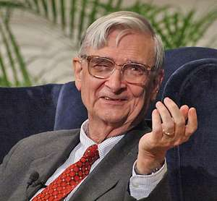
“If history and science have taught us anything, it is that passion and desire are not the same as truth. The human mind evolved to believe in the gods. It did not evolve to believe in biology. Acceptance of the supernatural conveyed a great advantage throughout prehistory when the brain was evolving... The uncomfortable truth is that the two beliefs are not factually compatible. As a result those who hunger for both intellectual and religious truth will never acquire both in full measure.” Edward O. Wilson, Consilience: The Unity of Knowledge
https://www.britannica.com/biography/Edward-O-Wilson#ref990334
Notes:
I’ll leave you with this quote. In his book Consilience: The Unity of Knowledge (1998), American biologist and thinker Edward O Wilson strove to demonstrate the interrelatedness and evolutionary origins of all human thought. <read quote>

Slide 14
The End
(wash your hands)

